Slide 1


IGNITE THE PEAK
A 2024 Global Launch Strategy for Nike Air Max Ignite. Targeting Gen Z Trailblazers on Instagram & TikTok.

Slide 2


CAMPAIGN KPI OBJECTIVES
250M+
12%
SOCIAL IMPRESSIONS
ENGAGEMENT RATE
Goal 1: Dominate the TikTok #IgnitePeak challenge with 100k+ UGC entries in Week 1.
Goal 2: Drive 1.5M direct sessions to the SNKRS App via Instagram Story Shop links.

Slide 3
CORE CHANNEL STRATEGY
TIKTOK: THE VIRAL SPARK
Leveraging Branded Hashtag Challenges (#IgnitePeak) and 50+ Micro-influencer 'Unboxing' transitions to drive rapid awareness and UGC.
INSTAGRAM: CULTURAL HYPE
High-fidelity 'Swoosh Stories' and cinematic Reels focused on urban style integration. Utilizing IG Collabs with marquee athletes for elite credibility.

Slide 4
LAUNCH EXECUTION ROADMAP
TEASE
DROP
UGC WAVE
SUSTAIN
WEEKS 1-2: 15-second cryptic TikTok teasers & IG countdowns. Influencer seed kits distributed.
DAY 0: Global Live Stream on TikTok Shop. SNKRS App "Shock Drop" for members only.
WEEKS 3-4: #IgnitePeak challenge goes live. Best fan content featured on Nike main feeds.
MONTH 2+: Retargeting ads based on engagement. Limited edition colorway drops.

Slide 5
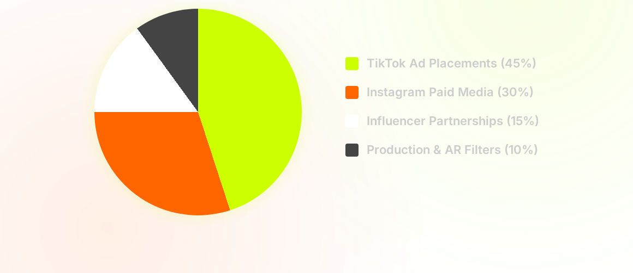
BUDGET & AD SPEND SPLIT
TOTAL PROJECTED ROAS: 4.2x

Slide 6

IMAGE SOURCES
https://fuckingyoung.es/wp-content/uploads/2026/02/2026_02_09_Nike_UnlimitedAir_Milano_0199.jpg
Source: fuckingyoung.es

